Slide 1
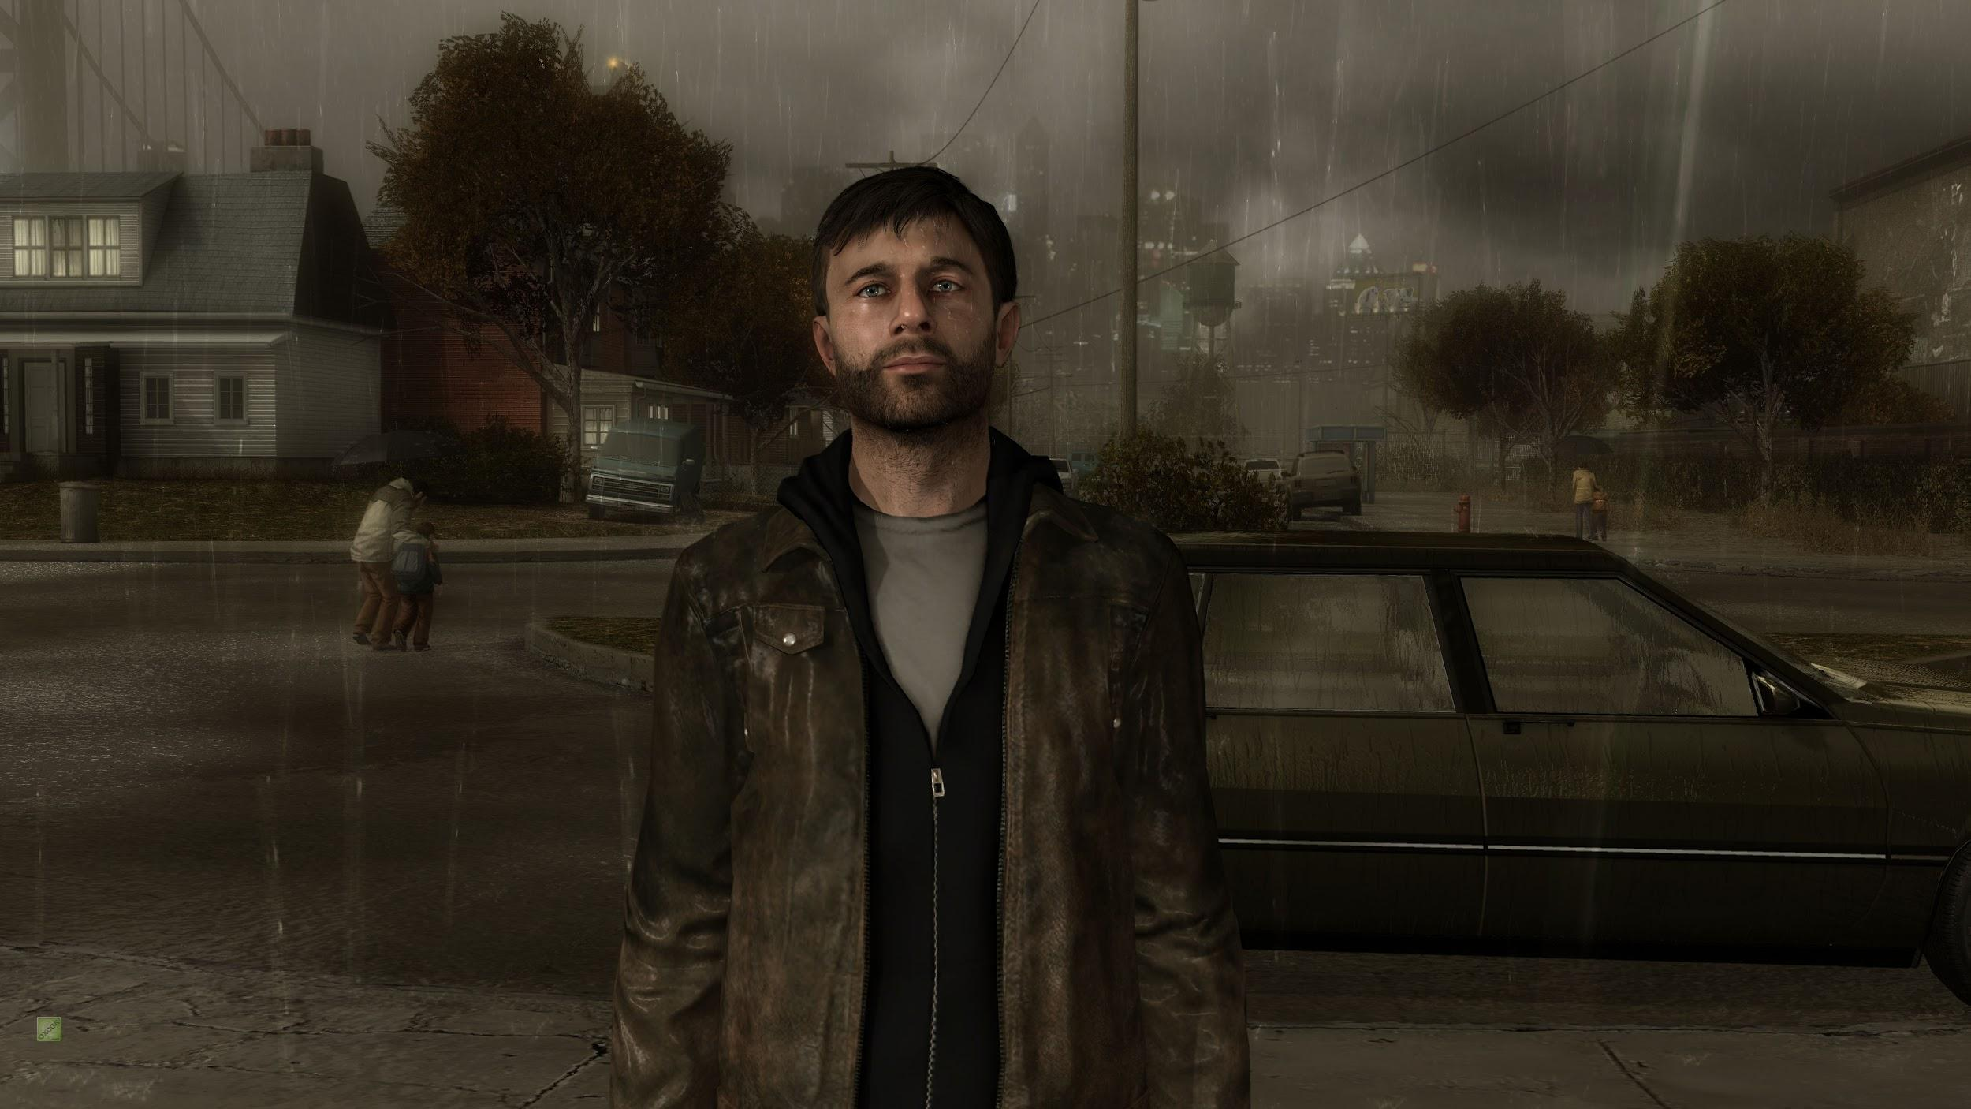
Weather & Simulation

Slide 2
Realistic weather simulation does not only enhance the cinematic quality of a game, but also enhances realism by introducing a less predictable and more compelling simulation of real world phenomenon
Notes:
For game worlds to be believable, the player must have some conception that there is life in the virtual world beyond what is immediately visible on the screen. It must always be raining somewhere, even if the sky is clear and sunny when we look outside our window.
The more familiar everything feels, the less we notice the machinery behind the illusion.

Slide 3
Topics Covered
Pros and Cons of Weather simulation
Examples of Good Implementations of Weather
Non-Particle Based Simulation
Rain
Particle Based Simulation
Tornado
Light Scattering

Slide 4
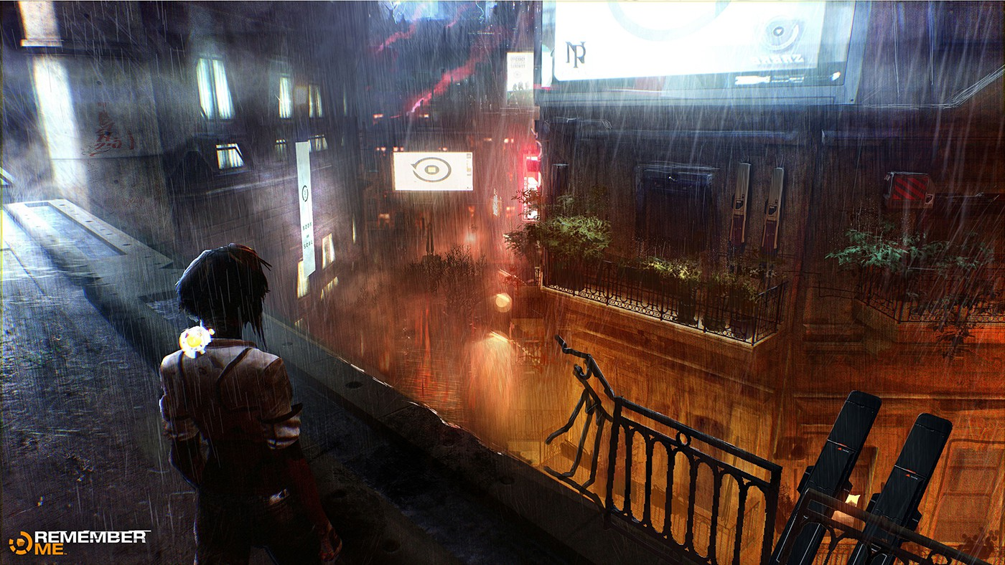
Pros and Cons of Weather Simulation

Slide 5
Pros
Weather adds another level of realism allowing the player to feel more connected to the gameplay
Immersive gameplay
Scenes appear more lively with a slight breeze blowing leaves, clouds gliding overhead and a morning mist.
Emergent gameplay
Dynamic weather may be used to help or hinder gameplayer
Visibility, slipperiness, etc.
Notes:
In early arcade classics like Pac-Man, Q*Bert, and Super Mario Bros., the “organisms” have only a vague, abstract relationship to their environments, which generally serve only to delimit their movement. (Barton)
Then came large open worlds
The next big thing:
Realistically depicting weather events like thunderstorms, winds, and moving clouds help support the idea of the game world as a living, dynamic navigable space

Slide 6
Cons
Realism != Fun
Too much simulation can be a detriment
Games are used to escape reality
Adding realistic weather comes with a cost
Compromise between cinematic quality and believable weather effects
Notes:
Jeffrey Katzenberg, producer of the animated film Shrek was asked about the greatest challenge faced by the computer graphics team, his response was “the pouring of milk into a glass” (Hiltzik and Pham, 2001, A1)
To look realistic, the rain drops must be of the right shape, fall at the right speed and angle (affected by wind), refract light, and reflect whatever surfaces that pass between them and the viewer’s eye. Not only must the falling rain look realistic; it must act realistically: soaking whatever it falls upon. (Barton)

Slide 7
Examples of Weather in Games

Slide 8
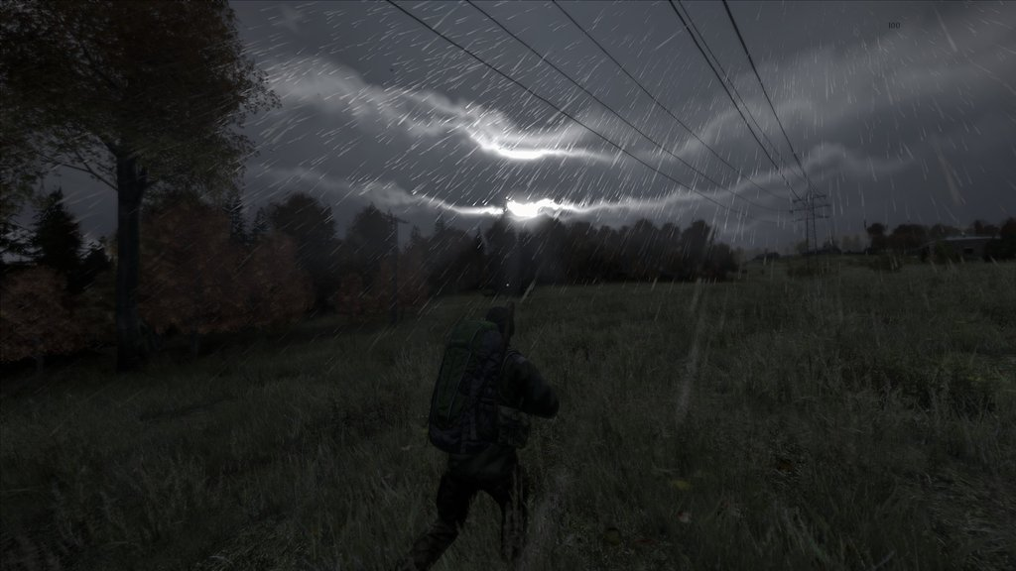

Slide 9
DayZ Stand Alone
Rain causes many problems for players as well as benefits
Body temperature drops
Fires are harder to start
Negate rain effects by wearing a raincoat, standing under trees or taking shelter indoors.
Can muffle firearm shots
Can be collected to drink
Notes:
Running causes body heat to go up based on temperature

Slide 10
Notes:
https://youtu.be/mNi8zJFI_Kk

Slide 11
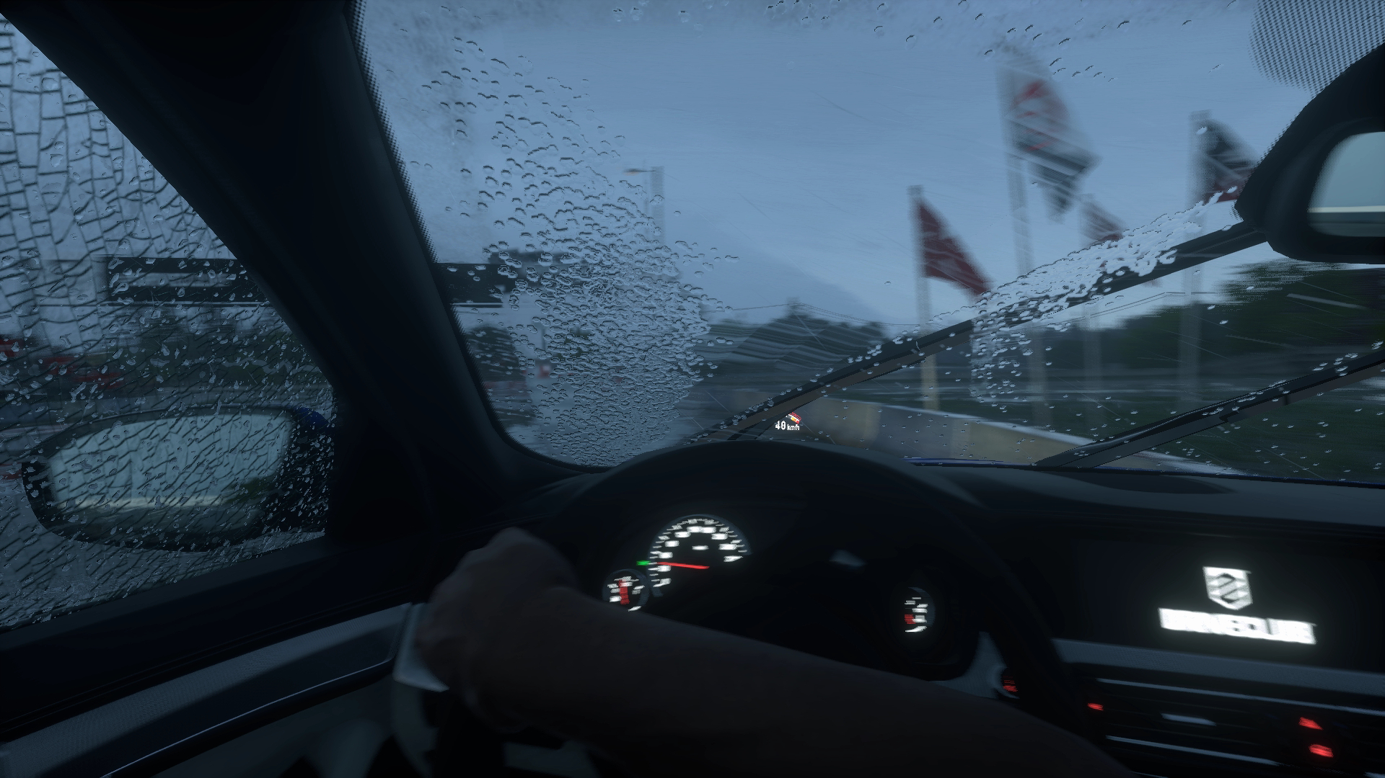

Slide 13
DriveClub
Water Droplets
Rain as individual particles affected by the games motion blur system.
Droplets move in reaction to velocity of the car and wiper blades
Rain is highly interactive with vehicles windshield but sparse on the rest of the vehicle.
Wet Surfaces
Puddles vary in size based on rain intensity
Notes:
--Leaves, Dirt, barriers and stone all receive moisture simulations.
--Volumetric Clouds
--game uses a physically-based rendering
http://www.eurogamer.net/articles/digitalfoundry-2014-driveclub-revisited-is-dynamic-weather-a-game-changer

Slide 14
Precipitation (Rain) Implementation
Notes:
So that is a little bit about why to use weather and some pros and cons…
Now Alan is going to talk about...

Slide 15
Aspects to Rain Simulation
Raindrops
Splash Effect
Glass Droplets/Wall Glides
Many different implementations for all of these, depending on game/company.

Slide 16
Aspects to Rain Simulation
Raindrops
Splash Effect
Glass Droplets/Wall Glides
Many different implementations for all of these, depending on game/company.

Slide 17
Raindrops
Example implementations:
Particle system
Large textures
Concerns?
Realistic?
Efficient?

Slide 18
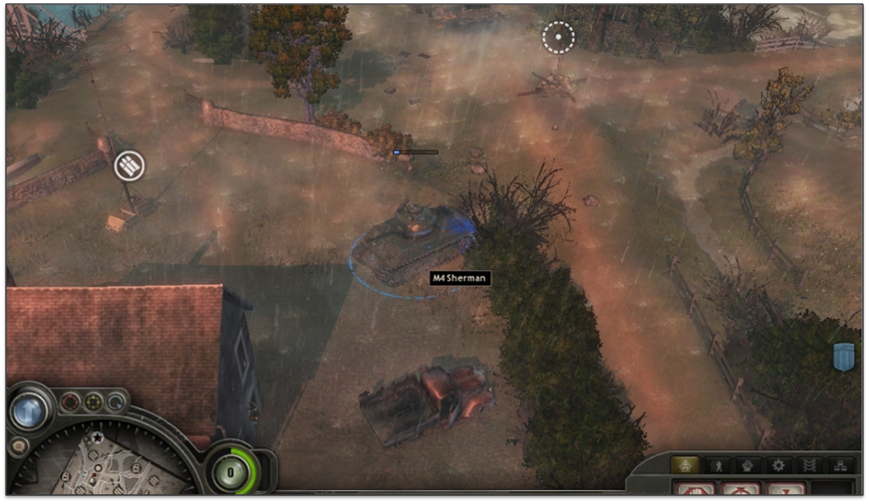
Particle System
What is a particle system?
Pros:
Easy to use; can look relatively realistic (wind effects?)
Cons:
Not very scalable
Example: Warhammer 40,000: Space Marine

Slide 19
Particle System Implementation
Requires rain texture
System is often attached to camera for performance
Relatively easy setup:
Unity:
Set texture, desired emit rate, possibly rotate
UE4:
Can use templates (first person, cave)

Slide 20
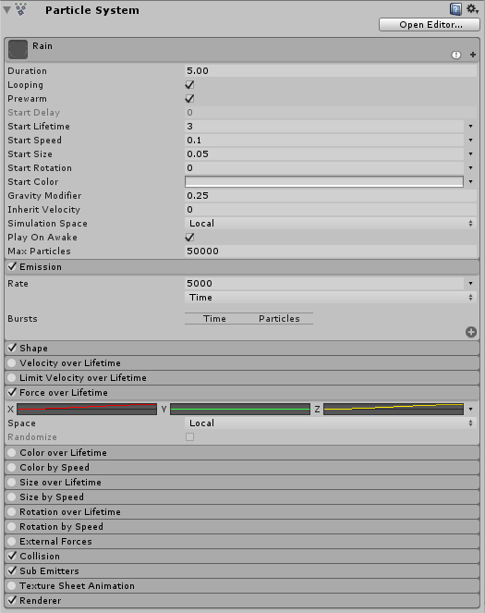
Particle System Implementation
Unity Example:
Rain Texture

Slide 21
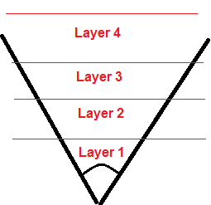
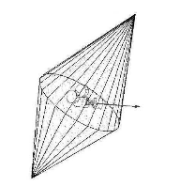
Large Texture Implementation
What is it?
Uses animated layered textures to provide depth
Textures are layered on a mesh centered around the camera
Rotation to different layers → wind effects

Slide 22
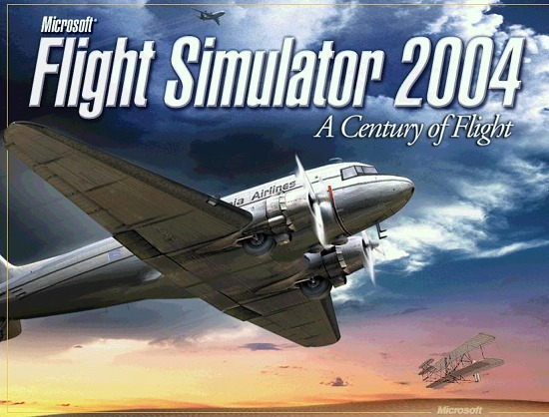
Large Texture Implementation
Pros:
Relatively very efficient
Cons:
Less intuitive; can complicate splash effect
Examples: Remember Me, Flight Simulator 2004

Slide 23
Aspects to Rain Simulation
Raindrops
Splash Effect
Glass Droplets/Wall Glides
Many different implementations for all of these, depending on game/company.

Slide 24
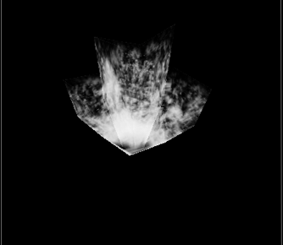
Splash Effect
Dependent on implementation
Often a simple polygon or particle system
Particle System?
Collide particles with objects
and emit the effect
Large Texture?
Much more difficult...

Slide 25
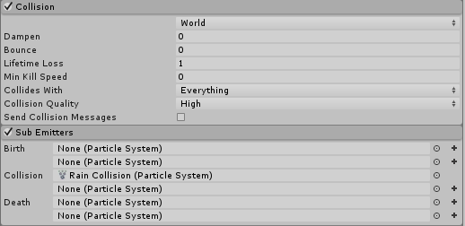
Particle System Splash Effect
Typical pros & cons for particle system:
Realistic/accurate, but performance heavy
Unity Example:

Slide 26
Large Texture Splash Effect
Splashes are separate from the actual rain drops
Uses a “depth map”
A birds-eye view of the area where splashes should occur
Randomly create splashes around the player/camera
Quick, but less realistic

Slide 27
Raindrop Occlusion
Occlusion?
How to hide raindrops when they shouldn’t appear
As usual, depends on the implementation
Particle System: Destroy particles when they collide
Large Texture: Estimate raindrop positions then use depth map to decide where to show splashes

Slide 28
Aspects to Rain Simulation
Raindrops
Splash Effect
Glass Droplets/Wall Glides
Many different implementations for all of these, depending on game/company.

Slide 29
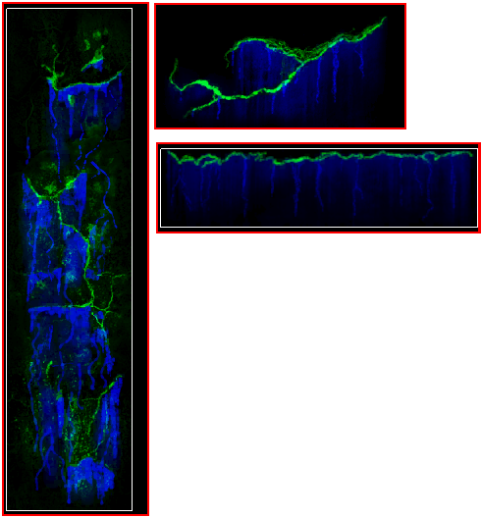
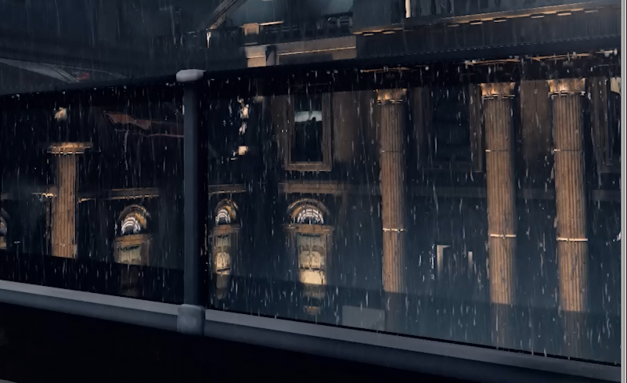
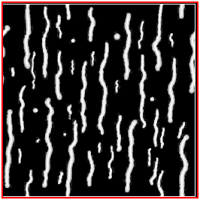
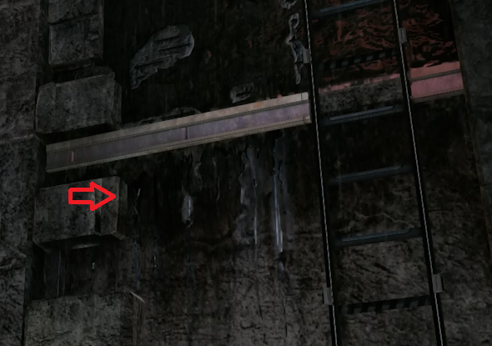
Glass Droplets/Wall Glides
Can be implemented using special textures
Idea is to run particles (that have certain lighting qualities) down the texture

Slide 30
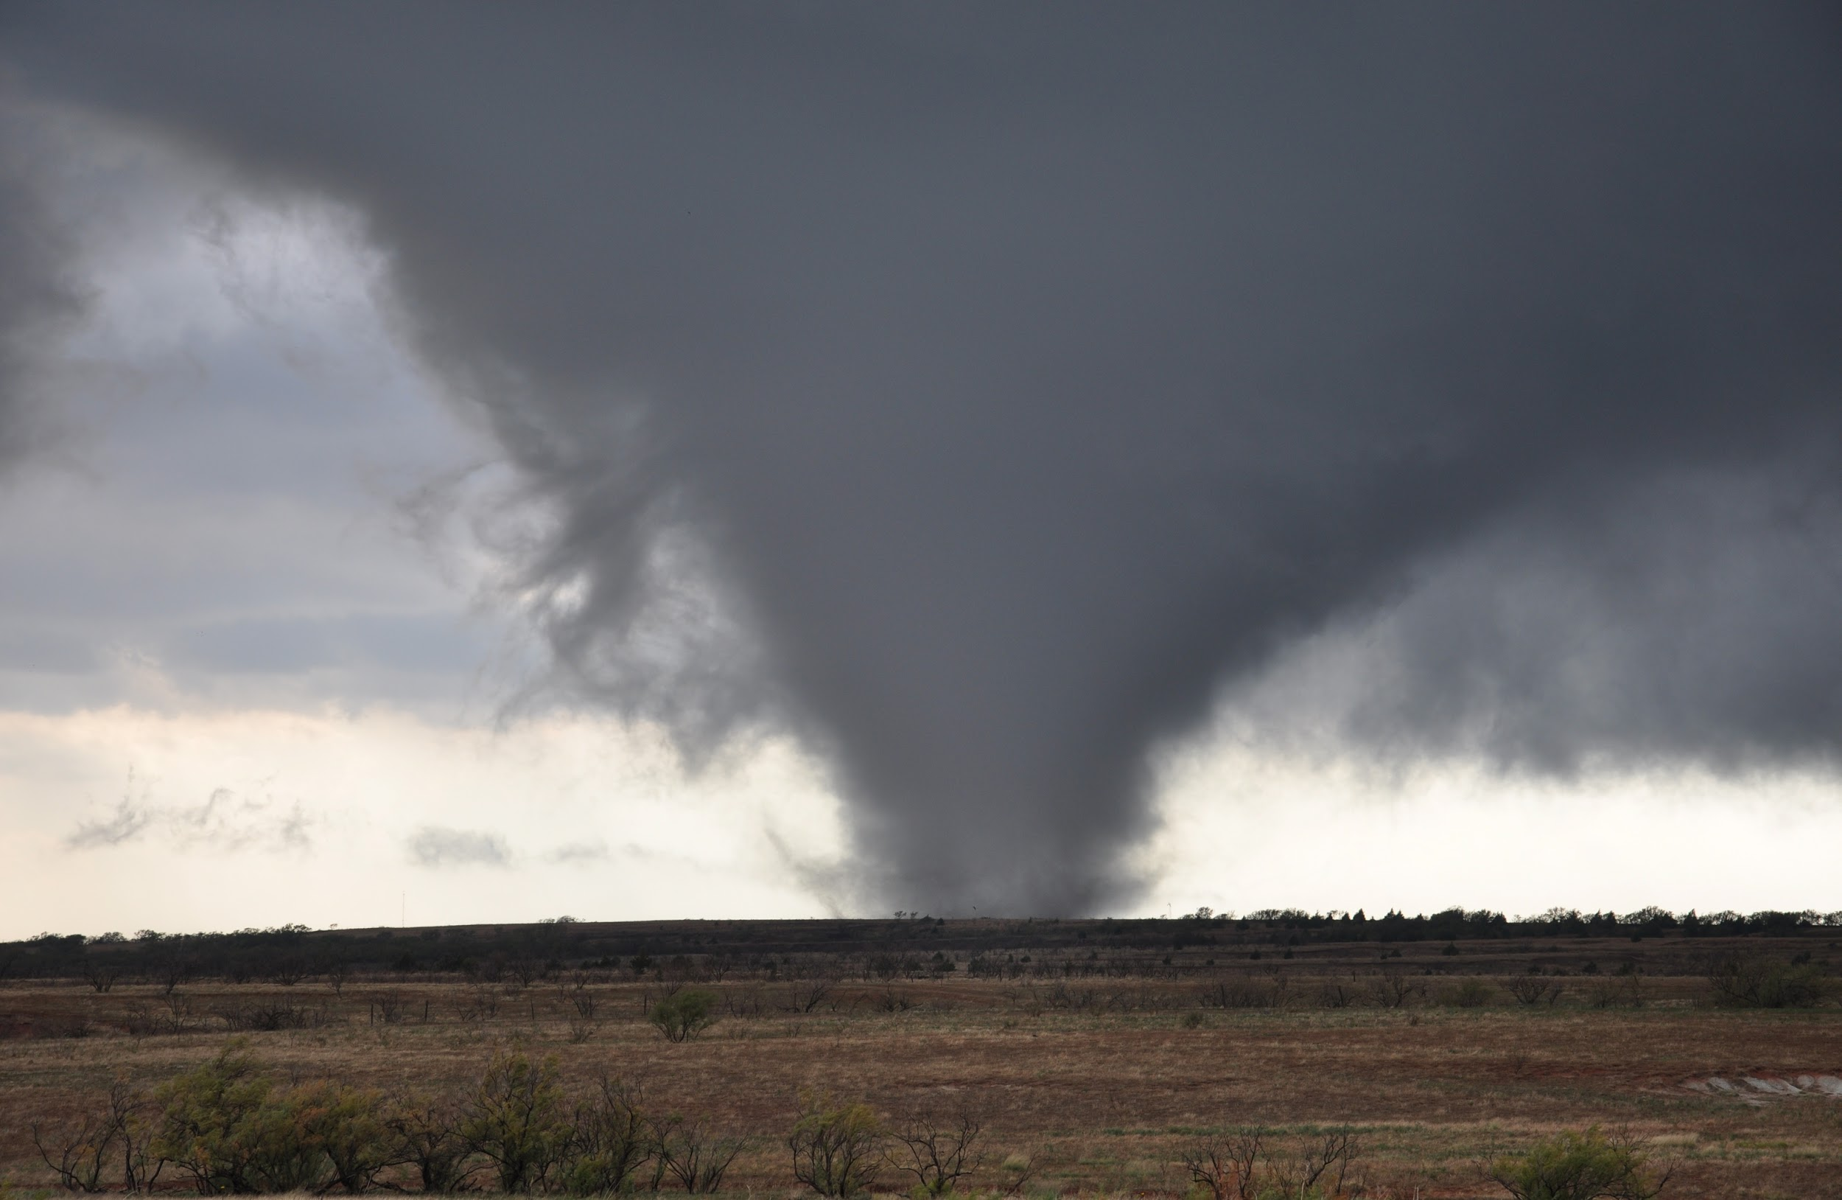
Tornado Simulation
Tornado Simulation

Slide 31
Why Make a Tornado?
Build a particle system from scratch
Use a pre-existing particle system from a game engine

Slide 32
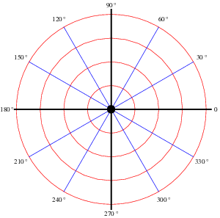
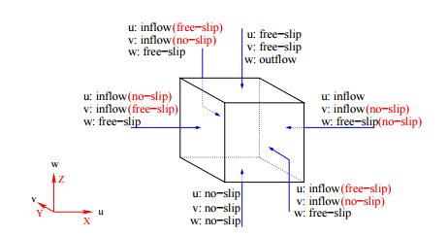
Modeling the Boundaries
polar coordinates versus cartesian

Slide 33
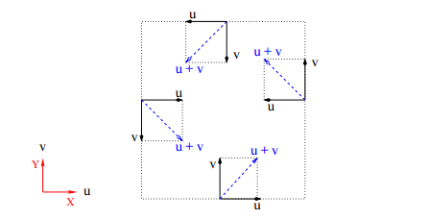
Top Down View of Cartesian
shows the counter-clockwise rotation found in northern hemisphere

Slide 34
Navier-Stokes Equation
u - fluid velocity vector
p - pressure
f - body forces(gravity, etc)
Re - Reynolds number(viscosity of the fluids)

Slide 35
Centrifugal force
u,v - velocity on the horizontal plane
x,y- particle position
xc, yc - position of center of tornado
Use an angle to decompose force
Use a = F/m to update velocity

Slide 36
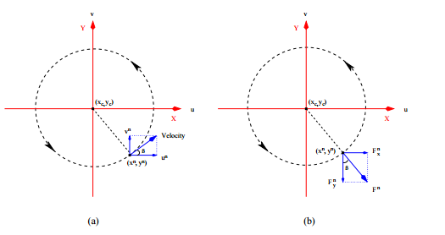
Decomposition
The particles rotate, go up slowly, and move gradually away from the center

Slide 37
How to Render the Particles?
The bounding volume is broken up into smaller cells
Each particle is mapped to a specific cell
A metaball method is used to calculate and smooth particle density for each cell

Slide 38
Metaball Calculation
C,R - set of cells whose centers are in C’s metaball
K(i,j,k) - number of particles of a cell in the metaball
r - distance of a cell to cell C
f - density contribution function
Cells are colored based on particle density

Slide 39
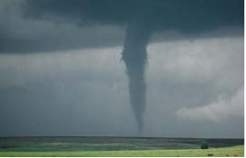
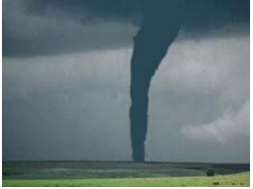
Results
Tornado in Neal, Kansas. May 30, 1982

Slide 40
Using a Game Engine to Make a Tornado
Why implement your own particle system when a game engine has already done it for you?

Slide 41
Demo

Slide 42
Light Scattering

Slide 43
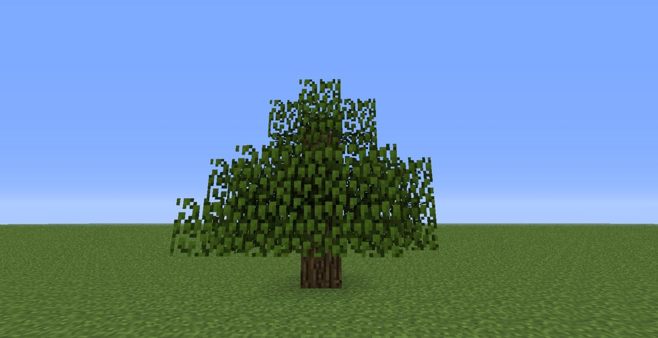
Why Light Scattering?
Real life doesn’t look like this It looks like this

Slide 44
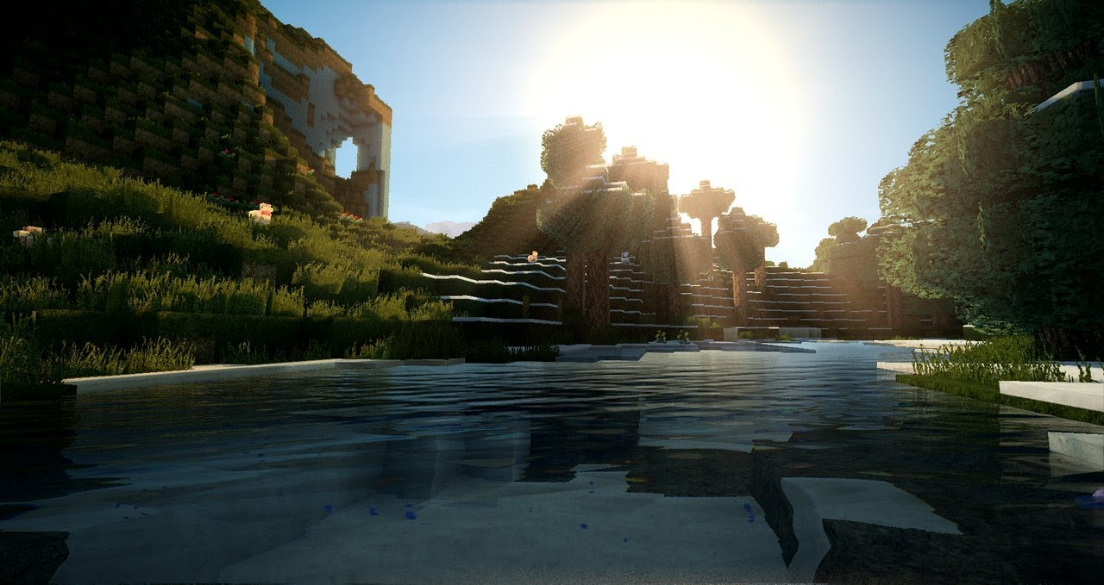
Why Light Scattering?
When combined you get something like this

Slide 45
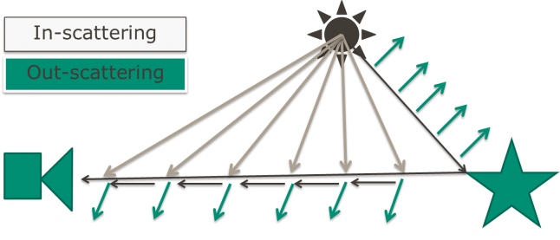
What is Light Scattering?

Slide 46
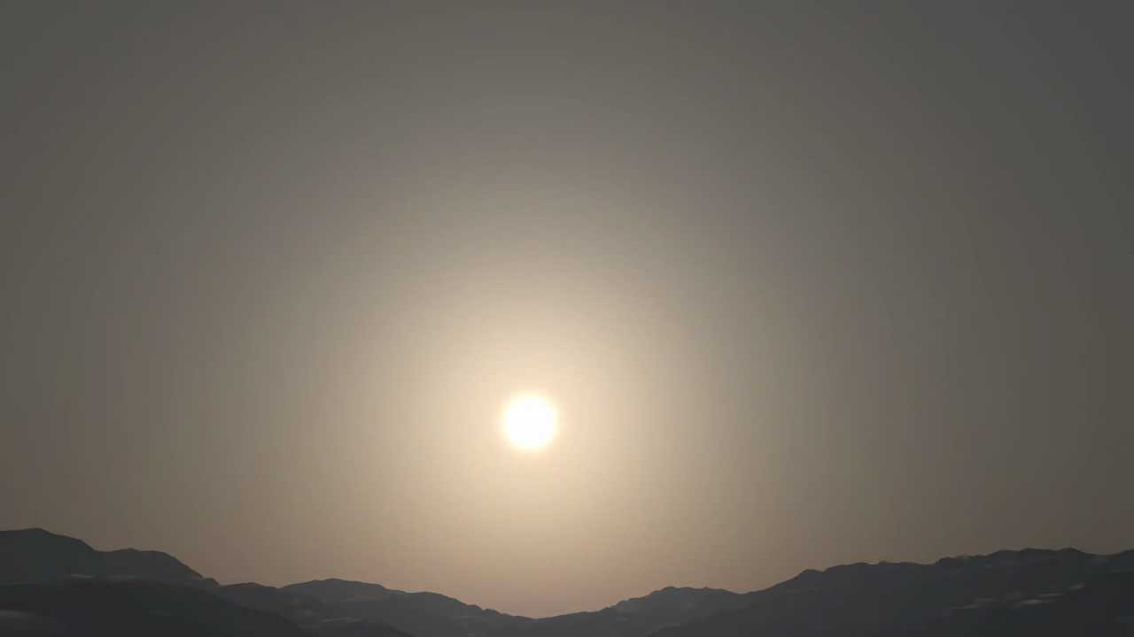
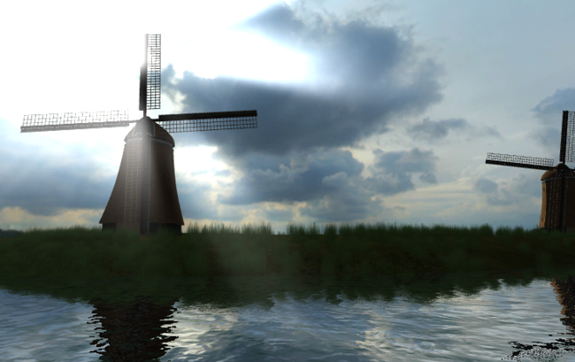
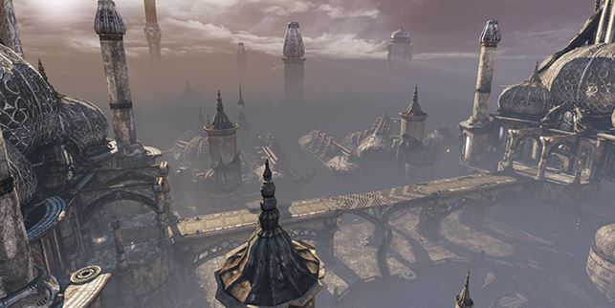
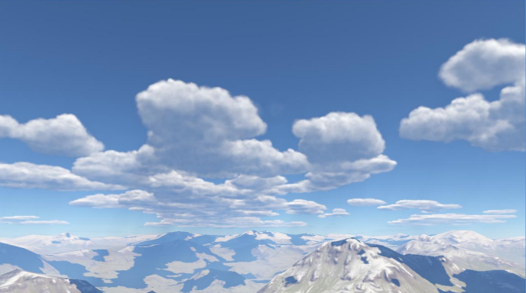
What uses Light Scattering?
The Atmosphere
Light shafts and “god rays”
Fog
Clouds

Slide 47
Common Techniques
Meshes, Billboards, and Particles
Post Process
Analytical Solutions
Raymarching

Slide 48
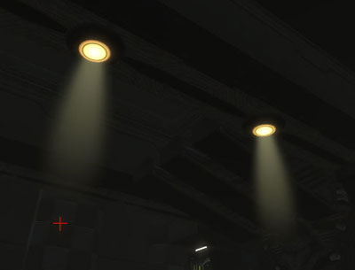
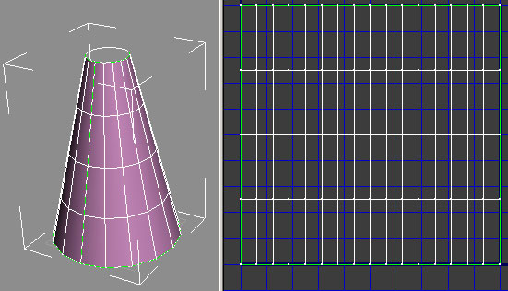
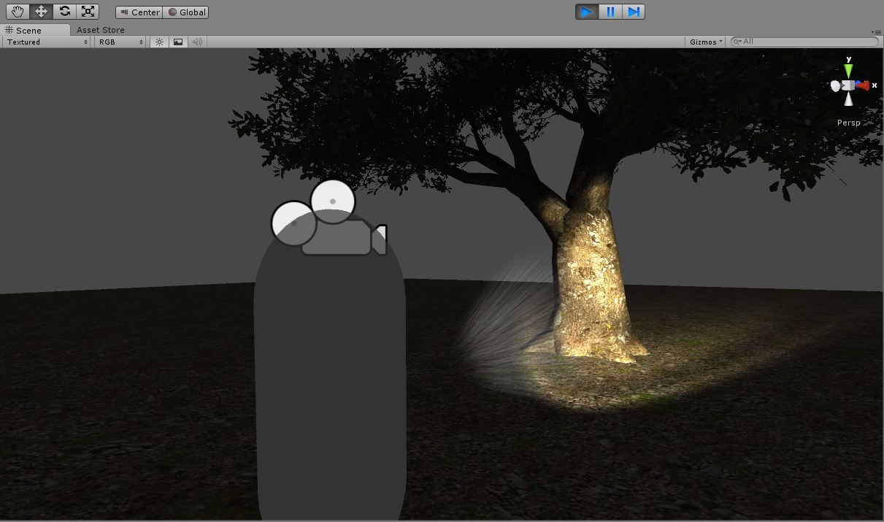
Meshes, Billboards, and Particles
Pros:
Simple
Cons:
Need some art skills
Time consuming
Not Realistic

Slide 49
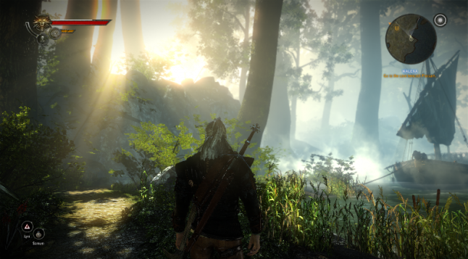
Post Process
Used primarily for light shafts
Used in Unity 4 Pro / Unity 5 / UE4
Pros:
Efficient
Looks artistic
Good for static lights through trees.
Cons:
Doesn’t stay when you move camera
Doesn’t look realistic
Doesn’t work well with near lights, fog, and transparency.

Slide 50
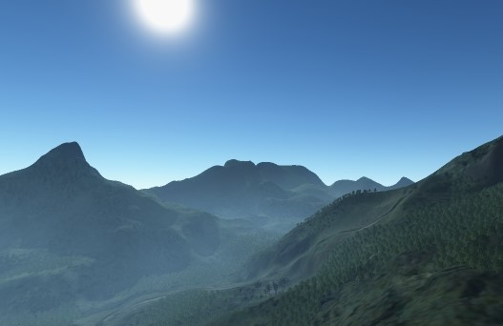
Analytical Solutions
Examples:
Linear Based Fog (old technique)
Unity 4 Free Version / Unity 5
Exponential Fog
Unity 4 Pro Version / Unity 5 (no light scattering)
UE4 (includes light scattering)
Pros:
Efficient
Looks Decent
Cons:
Exponential Fog w/ scattering only works well with uniform light
Doesn’t look very realistic without scattering.

Slide 51
Preetham-Hoffman (2003)
Outdoor real-time light scattering technique.
There are four parts:
The Phase function
The Out-Scattering
The In-Scattering
The Surface Scattering

Slide 52
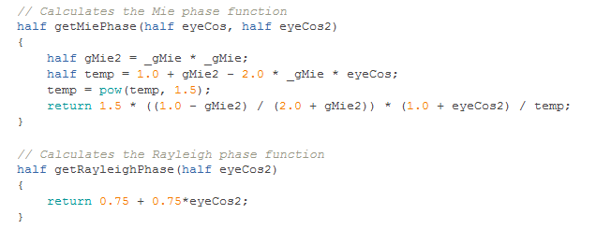
The Phase Function
Rayleigh Scattering -> Simulates the atmosphere and sun(g = 0)
Mie Scattering -> Simulates haze, pollution, sun halo ( -0.75 <= g <= -0.999)

Slide 53
The Out Scattering function
K(λ) = Is the scattering coefficient for either Mie or Rayleigh
h = the height of the sample point compared to the inner radius of the atmosphere
H0 = the scale between the two radii

Slide 54
The In Scattering Equation
K(λ) = Is the scattering coefficient for either Mie or Rayleigh
h = the height of the sample point compared to the inner radius of the atmosphere
H0 = the scale between the two radii
-t(PPc,λ) - t(PPd,λ) is adding the two out scatterings together
F(θ, g) = the phase function
Is(λ) = the sun’s intensity

Slide 55
The Surface Scattering Equation
I'_{v} (l) = I_{v} (l) + I _{e}(l) x exp (–t (P_{a} P_{b} , l))
I_{v} (l) = In-Scattering for sky
I _{e}(l) = In-Scattering for sun
exp (–t (P_{a} P_{b} , l)) = Out-Scattering from Sun/Earth due to reflection

Slide 56
Demo

Slide 57
Hosek-Wilkie (2012)
Improved the Preetham-Hoffman model to look more realistic

Slide 58
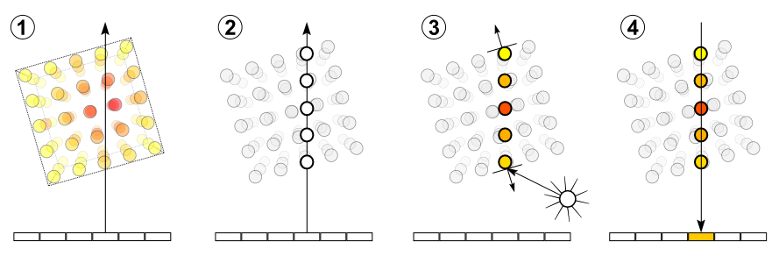
Ray Marching
The process is as follows:
Cast a ray from your camera towards the object.
Sample the points along the ray.
For each point calculate the shading and add it to the density of the pixel.
Project the pixel with the color density on the screen.

Slide 59
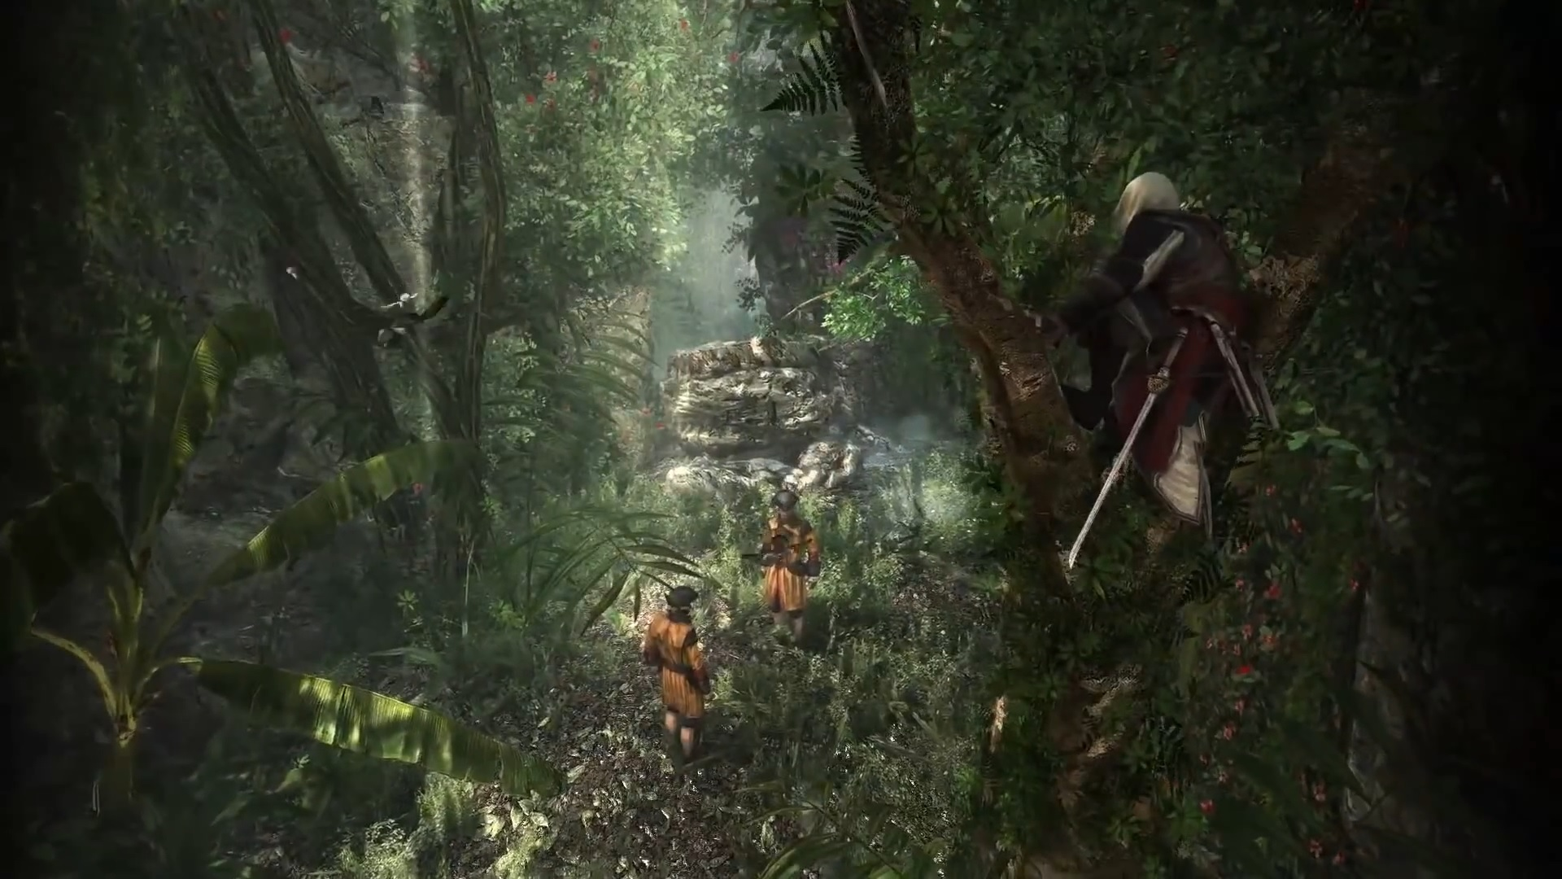
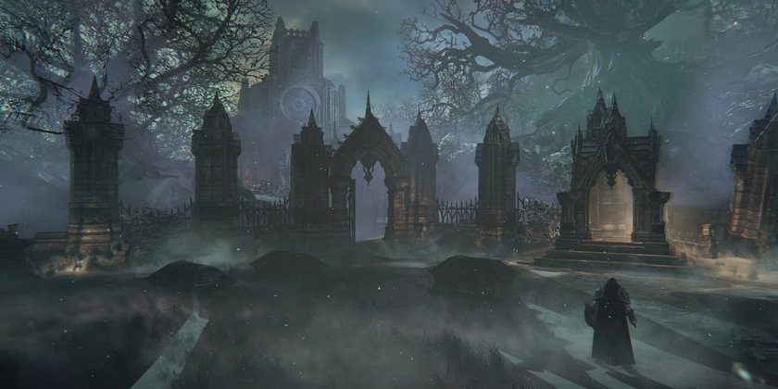
Ray Marching
Ray Marching is the most current technique and has been used in games like Assassin's Creed IV and Lords of the Fallen.
Pros:
Looks very realistic
Very Expensive due to sampling per pixel
Cons:
Need to have an optimization technique as well.

Slide 60
Questions?

Slide 61
References
http://www1.cs.columbia.edu/CAVE/databases/rain_streak_db/rain_streak.php
https://seblagarde.wordpress.com/2012/12/27/water-drop-2a-dynamic-rain-and-its-effects/
http://www.ofb.net/~niniane/rainsnow/rainsnow-sketch.pdf
https://cs.uwaterloo.ca/~jwlwan/papers/WanDing05.pdf
http://3dnemo.com/Tutorials/3dnemo-tornado-3d.html
http://www.slideshare.net/proyZ/relics-fx-system
http://http.developer.nvidia.com/GPUGems2/gpugems2_chapter16.html
http://cgg.mff.cuni.cz/projects/SkylightModelling/
http://www.slideshare.net/BenjaminGlatzel/volumetric-lighting-for-many-lights-in-lords-of-the-fallen
http://www.gamasutra.com/blogs/BartlomiejWronski/20141208/226295/Atmospheric_scattering_and_volumetric_fog_algorithm__part_1.php
http://en.wikipedia.org/wiki/Volume_ray_casting

